Slide 1
Digital Portfolio
STUDENT NAME: CHIRANJEEVI P
REGISTER NO AND NMID: 2428B0303/ BE54F89B637B1A0B1094135FE5AD4F1D
DEPARTMENT: B.Sc.COMPUTER SCIENCE WITH DATA ANALYTICS
COLLEGE: KPR COLLEGE OF ARTS SCIENCE AND RESEARCH
UNIVERSITY:BARATHIYAR UNIVERSITY

Slide 2
PROJECT TITLE
Projects & Mini-Projects Showcase

Slide 3


AGENDA
Problem Statement
Project Overview
End Users
Tools and Technologies
Portfolio design and Layout
Features and Functionality
Results and Screenshots
Conclusion
Github Link
3/21/2024 Annual Review

Slide 4

PROBLEM STATEMENT
In today’s academic and professional environment, students often struggle to present their innovative ideas and technical skills effectively. There is a need for a structured platform where projects and mini-projects can be showcased to highlight problem-solving abilities, creativity, and technical knowledge. This showcase aims to bridge the gap between theoretical learning and practical implementation, providing an opportunity for students to demonstrate their capabilities through real-world applications

Slide 5

PROJECT OVERVIEW
This showcase presents a collection of projects and mini-projects developed by students, focusing on real-world problem solving and innovative solutions. Each project demonstrates the application of theoretical concepts into practice, covering areas such as web development, data analytics, machine learning, IoT, and software engineering. The objective is to highlight creativity, teamwork, and technical expertise, while providing hands-on experience in building scalable and impactful solutions.

Slide 6

WHO ARE THE END USERS?
Students – to learn, experiment, and showcase their skills.
Faculty Members – to evaluate projects and provide guidance.
Industry Experts & Recruiters – to identify talent and innovative solutions.
Researchers – to explore project ideas for further study.
General Audience – to gain insights into practical applications of technology

Slide 7

TOOLS AND TECHNIQUES
Programming Languages: Python, Java, C, C++
Web Technologies: HTML, CSS, JavaScript, Bootstrap
Frameworks: Django, React, Node.js
Databases: MySQL, PostgreSQL, MongoDB
Development Tools: Git, GitHub, VS Code
Techniques: Data Analysis, Machine Learning, API Integration, Testing & Debugging

Slide 8
POTFOLIO DESIGN AND LAYOUT
User-Friendly Interface – Simple, clean, and easy to navigate.
Consistent Theme – Uniform colors, fonts, and styles
.
Project Sections – Organized into categories (Mini-projects, Major projects).
Visual Elements – Use of icons, charts, and images to enhance clarity.
Responsive Layout – Optimized for different screen sizes.
Highlight Achievements – Key features, outcomes, and learning points.
8

Slide 9
FEATURES AND FUNCTIONALITY
Interactive Interface – Easy navigation with clear menus.
Project Showcase – Displays mini and major projects with details
Search & Filter Options – Quick access to specific projects.
Multimedia Support – Images, charts, and demo videos included.
Responsive Design – Works smoothly across devices.
Collaboration Support – Allows teamwork and version control.
Documentation – Provides clear project descriptions and outcomes

Slide 10

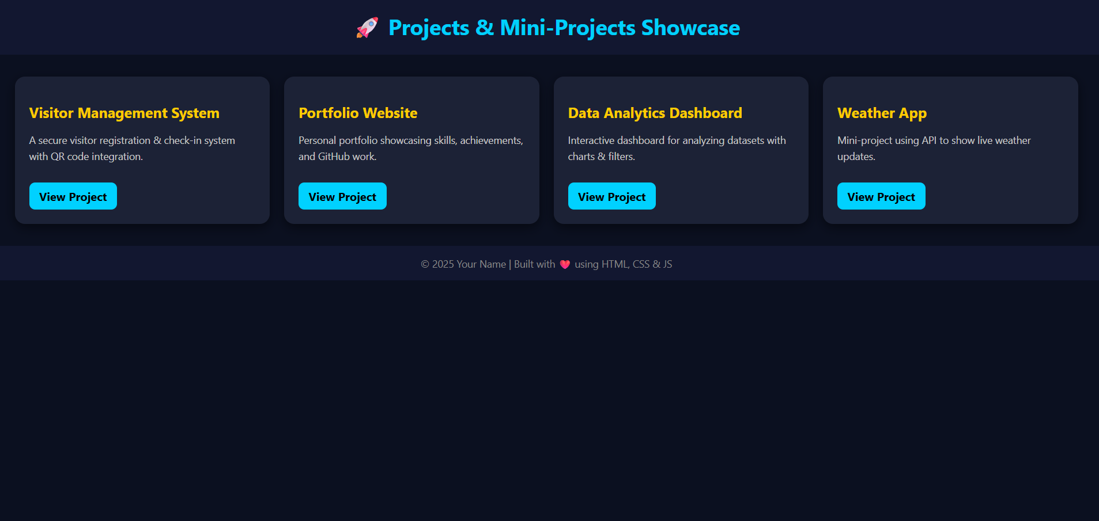
RESULTS AND SCREENSHOTS
Successful Implementation – Projects executed as per objectives.
Performance Analysis – Measurable outcomes and improvements observed.
User Experience – Simple and effective interfaces tested with users.
Innovation Showcase – Demonstrated creativity and problem-solving skills.
Screenshots/Visuals – Key project interfaces, workflows, and outputs displayed for better understanding.
3/21/2024 Annual Review
10

Slide 11
CONCLUSION
Projects and mini-projects provided a platform to apply theoretical knowledge into practice.
Enhanced skills in problem-solving, teamwork, and innovation.
Gained hands-on experience with tools, techniques, and technologies.
Showcased creativity, technical expertise, and practical implementation.
Built a foundation for future research, higher studies, and career opportunities.
11

Slide 12
Github id:
https://c01040724-hash.github.io/chiranjeevi123/

